Slide 1
Comparison of Popular 3x3 Advanced Methods
COLL 134
Week 7

Slide 2
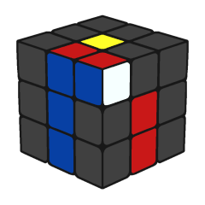
CFOP
Cross completed, F2L in progress
Popularized by Jessica Fridrich, but many prior developers
Average move count: 55-60
Algorithms: 41 F2L (optional) + 57 OLL + 21 PLL = 78 or 119 total
Cross (David Singmaster)
F2L (First Two Layers, René Schoof)
OLL (Orient Last Layer)
PLL (Permute Last Layer)

Slide 3
LBL → CFOP
LBL transitions seamlessly to CFOP (hence their popularities)
Combine steps
LBL
First layer edges (Cross)
First layer corners
Middle layer edges
Last layer edge orientation (EOLL)
Last layer corner orientation (COLL)
Last layer corner permutation (CPLL)
Last layer edge permutation (EPLL)
CFOP
Cross
First Two Layers (F2L)
Orient Last Layer (OLL)
Permute Last Layer (PLL)

Slide 4
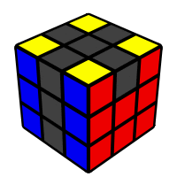
Roux
CMLL completed
Invented by Gilles Roux
Average move count: 45-50
Algorithms: 42 CMLL
First block
Second block
CMLL (Corners of Last Layer, ignoring M-slice)
L6E (Last 6 Edges)

Slide 5
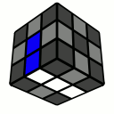
ZZ
EOLine completed
Invented by Zbigniew Zborowski
Average move count: 45 with EOLine, 53 with EOCross
Algorithms: highly variable, 10-20 LL up to 500+ (ZBLL)
EOLine (Edge Orientation and DF-DB Line)
EOCross (Edge Orientation and Cross)
F2L (First 2 Layers)
LL (Last Layer, edges already oriented)

Slide 6
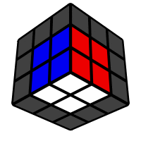
Petrus
2x2x2 block completed
Invented by Lars Petrus
Average move count: 40-50 depending on practice
Algorithms: highly variable, 10-20 LL up to 500+ (ZBLL)
Build 2x2x2 block
Expand to 2x2x3 block
Orient remaining edges
Finish F2L (First 2 Layers)
LL (Last Layer, edges already oriented)

Slide 7
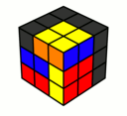
Heise
Heise blocks completed
Invented by Ryan Heise
Average move count: 40
Algorithms: none
Build 4 1x2x2 (Heise) blocks
1 color must remain unused
Align Heise blocks + EOLL (Edge Orientation of Last Layer)
Solve 2/5 remaining corners and all 5 remaining edges
Solve last 3 corners

Slide 8
Advantages and Disadvantages
CFOP
Heise
Learning (lowest to highest difficulty)
CFOP < Roux < ZZ ≈ Petrus <<<<<<<<<< Heise
Speed (least to most time)
CFOP < Roux ≈ ZZ < Petrus <<< Heise
Move count (lowest to highest)
Heise < Roux < ZZ ≈ Petrus < CFOP
Algorithm count (lowest to highest)
Heise <<< Petrus* < ZZ* < Roux < CFOP
*assuming no use of extensive LL subsets such as ZBLL
Ergonomics
“it depends”
Efficiency
Difficulty/Time

Slide 9
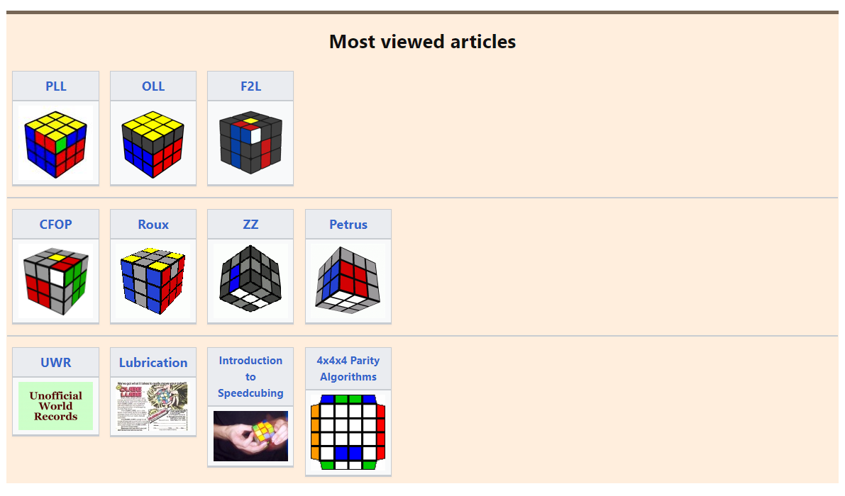
Further Interest
Go to speedsolving.com/wiki for more information

Slide 10
Midterm Project Details
See document posted in Canvas Assignment: “Midterm Project”

